Slide 1
Innovative test solution
Provider
- Probe pin Datasheet -

Slide 2
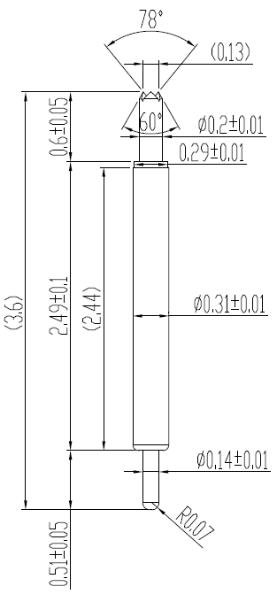
※ Special – POGO pin for High current
IVB-SAR-360-031-A200-00
Pitch | 0.4 mm
Total Length | 3.6 mm
Use Length | 3.3 mm
Use Stroke | 0.3 mm
Recommended Top Plunger Stroke | 0.2 mm
Recommended Bottom Plunger Stroke (Pre-load) | 0.1 mm
Max Stroke | 0.5 mm
Spring Force at Use Stroke | 20 gf at 0.3 mm stroke
Operating Temperature | -40 to +200℃
DC Resistance | Avg. 36.8 mΩ at 0.3 mm stroke
Current Rating (Continuous 1Hour) | 4.7 A
Current Rating (Duty cycle 30%) | 5.5 A
Self Inductance | 0.98 nH
Bandwidth @ -1dB | 27.04 GHz
Top Plunger | BeCu / Pd
Bottom Plunger | BeCu / Au
Barrel | Pb / Au
Spring | SUS / Au
Insertion Life | 200,000 cycles

Slide 3
Thank you.

